Slide 1
Visualizing consequences of genetic variation in biological networks
Ling Fung Tang^{1,5}, Michael L Heuer^{*2}, Nathan Salomonis³, Alexander Pico⁴, Pui Yan Kwok^{1,5,6}
University of California, San Francisco, Institute of Human Genetics, San Francisco, CA, 94143
Harbinger Partners, Inc., IT Consulting, St Paul, MN, 55127
Cincinnati Children’s Hospital, Department of Pediatrics, Division of Biomedical Informatics, Cincinnati, OH, 45229
Gladstone Institutes, Institute of Cardiovasular Diseases, San Francisco, CA, 94158
University of California, San Francisco, Cardiovascular Research Institute, San Francisco, CA, 94158
University of California, San Francisco, Department of Dermatology, San Francisco, CA, 94115
*lead developer

Slide 2
Motivation
Visualize variant consequence in the context of network, with which biologists are most comfortable
Eliminate black box filtering
Provide annotation from multiple dimensions from multiple sources for multiple genes in the same screen

Slide 3
Network example
Goh et al. Proc Natl Acad Sci USA. (2007) 104:8685-90

Slide 4
Network example
Goh et al. Proc Natl Acad Sci USA. (2007) 104:8685-90

Slide 5
Network example
Ciriello, G., Miller, M. L., Aksoy, B. A., Senbabaoglu, Y., Schultz, N., & Sander, C. (2013). Emerging landscape of oncogenic signatures across human cancers. Nature genetics, 45(10), 1127–1133. doi:10.1038/ng.2762

Slide 6
Architecture
Vcf file
Cytoscape-canvas
Variation-app
snpEff/EVP
GEMINI
ClinVar
ESP6500
dbsnp
Disease-centric
Cytoscape-table
Encode
Ensembl

Slide 7
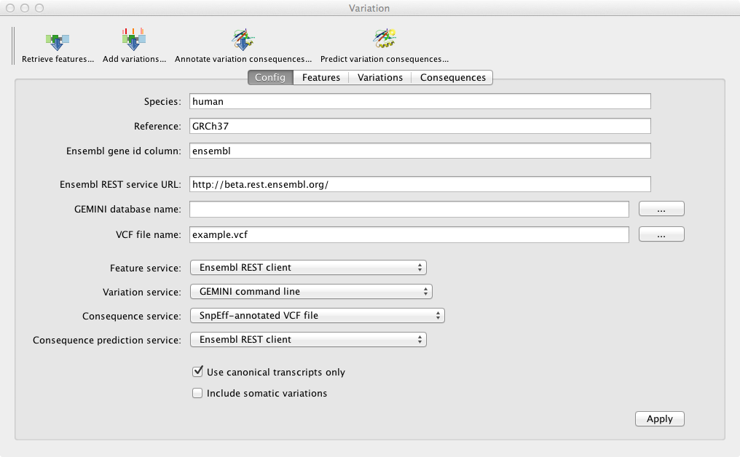
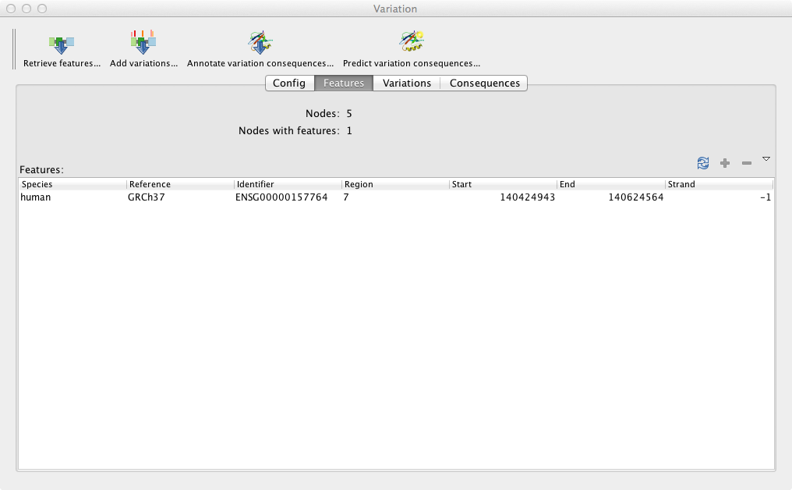
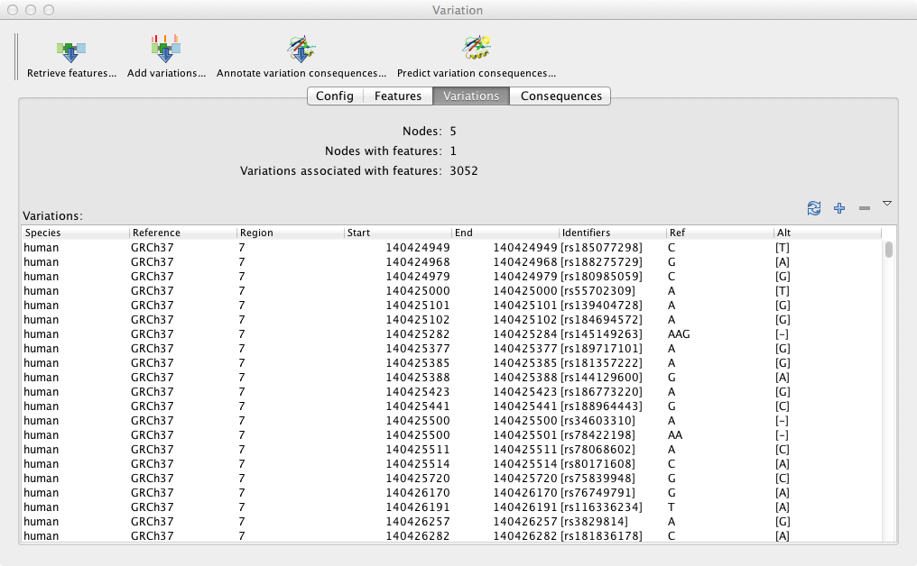
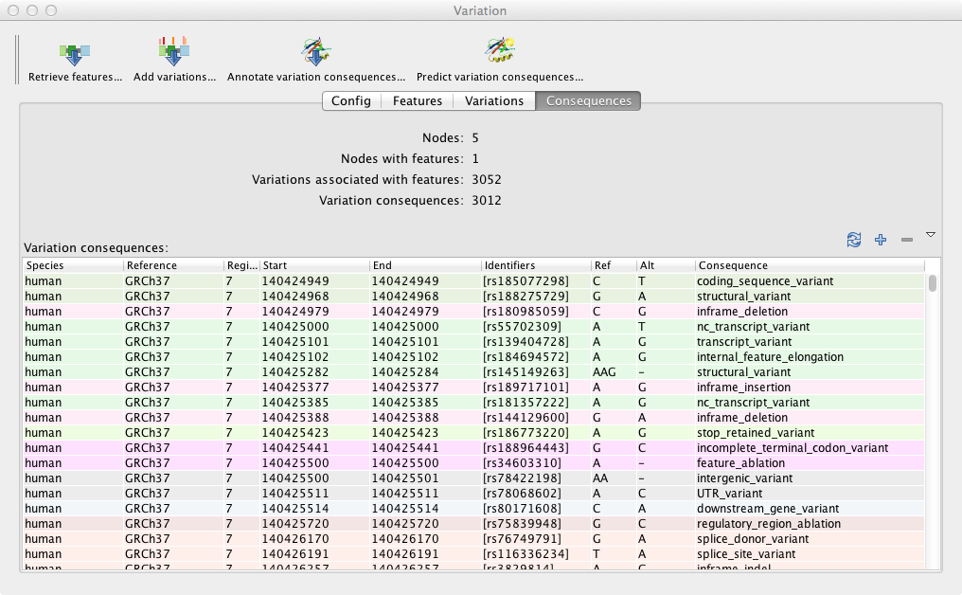
Current screenshots

Slide 8
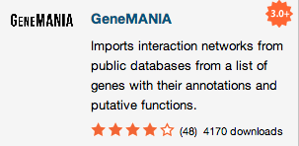
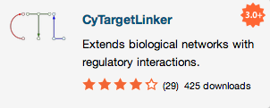
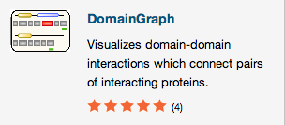
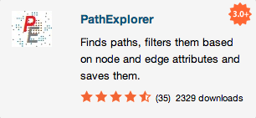
Disease-centric pathway coupled with nice Cytoscape community

Slide 9
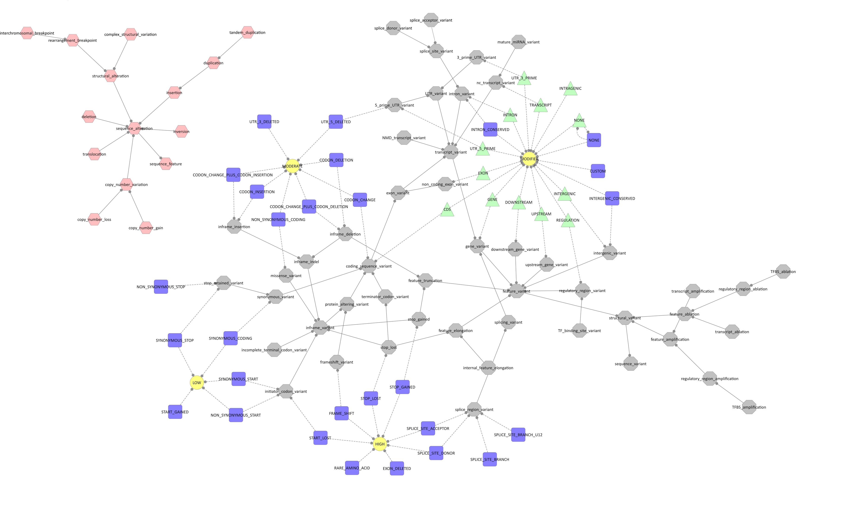
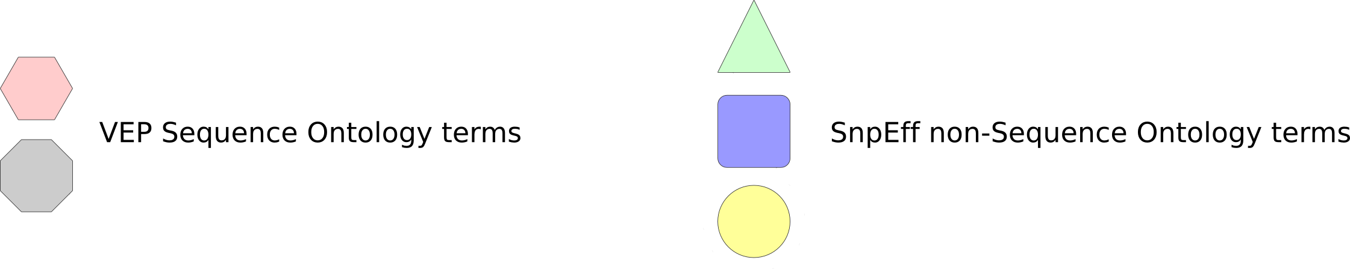
Issue with sequence ontology
https://github.com/arq5x/gemini/issues/207

Slide 10
Features in the plan
Visualize the consequence information on the canvas, supplement the details in the table
Provide time (t) and count (c) as a dimension for somatic mutation gain in cancer genomes
Allows correlations with different databases or datasets
Non-variant annotation query
User-annotation on Cytoscape (linkout to SNPedia?)

Slide 11


Availability
The Variation app for Cytoscape 3 is Free/Libre and Open Source software.
Licensed GNU Lesser General Public License (LGPL), version 3 or later.
Source in subversion repository at
https://svn.code.sf.net/p/dishevelled/code/trunk/variation-cytoscape3-app
Developer home page at
http://www.dishevelled.org/variation-cytoscape3-app
Will be available on the Cytoscape 3 App Store in Q1 2014 at
http://apps.cytoscape.org/apps/variation

